Slide 1
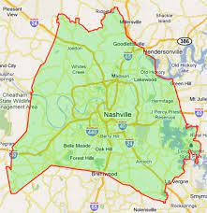
DAVIDSON COUNTY
REPORTED POLICE INCIDENTS
Years Evaluated: 2017 to 2023
Safest City/Neighborhood Area

Slide 2
DO POLICE INCIDENTS INCREASE/DECREASE IN DAVIDSON COUNTY WHEN THE POPLUATION INCREASES AND/OR DECREASES?
WHO IS BEING IMPACTED BY VIOLENT CRIME?
WHERE ARE THE BEST CITY/NEIGHBORHOOD AREAS TO LIVE IN WITH THE LOWEST POLICE INCIDENTS?

Slide 3
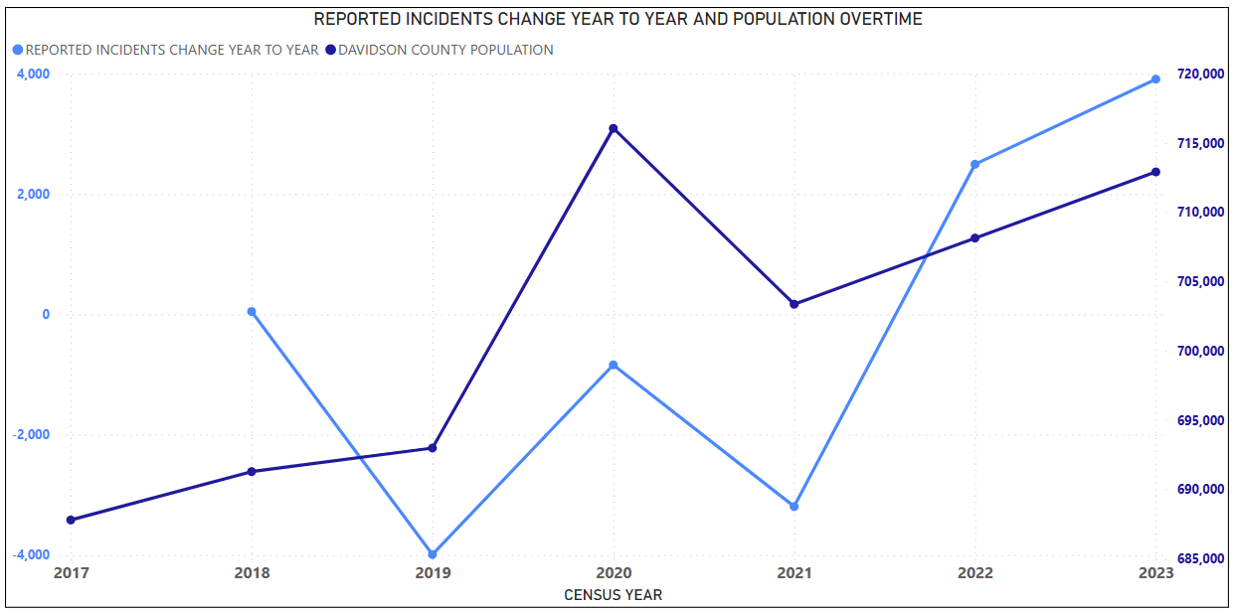
AS THE POPULATION INCREASES/DECREASES THE REPORTED POLICE INCIDENTS (CRIME) INCREASE/DECREASE WITH THE FLUXUATION OF THE POPULATION ACCORDINGLY. THE POPULATION DIRECTLY IMPACTS CRIME.

Slide 4
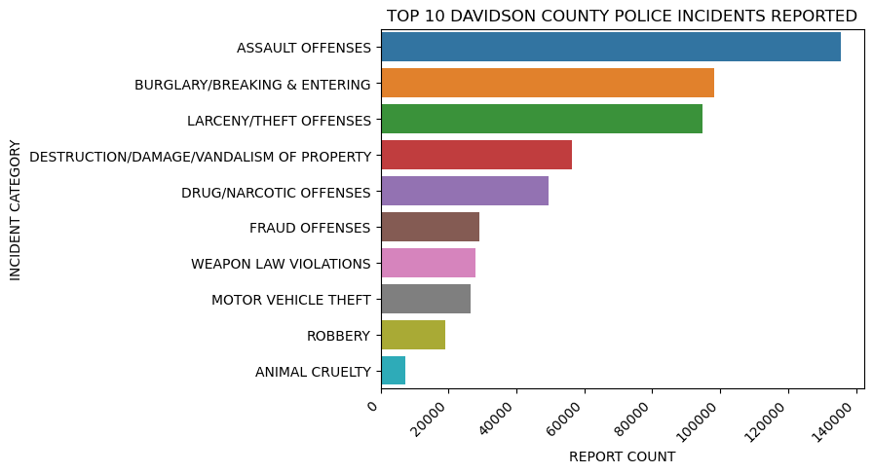
TOP 10 REPORTED INCIDENTS

Slide 5
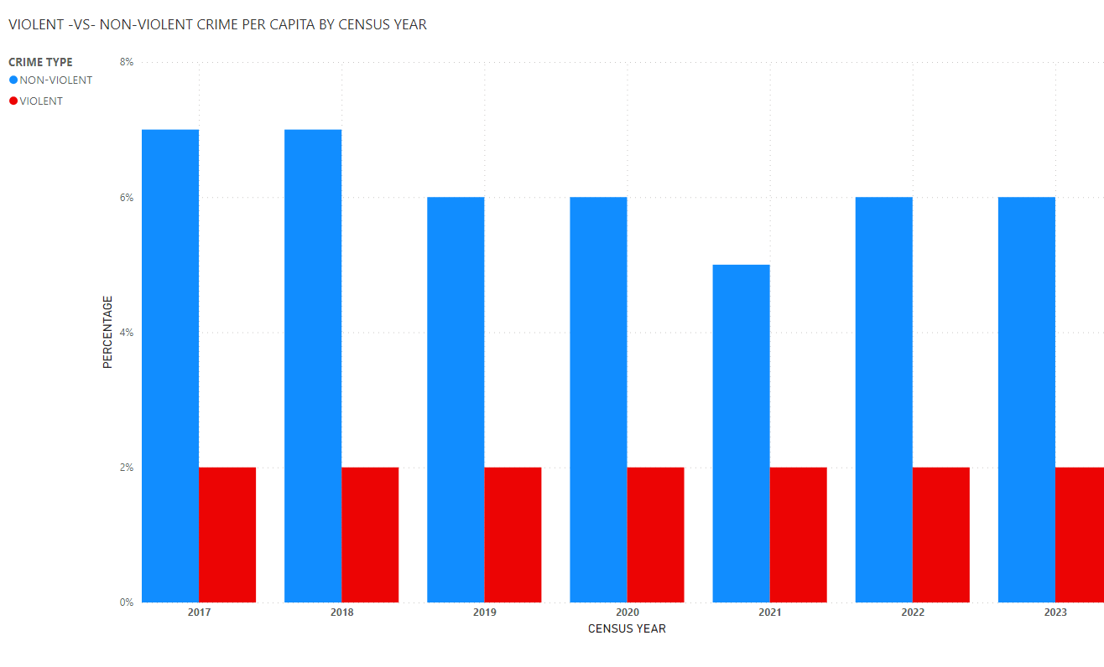

Slide 6
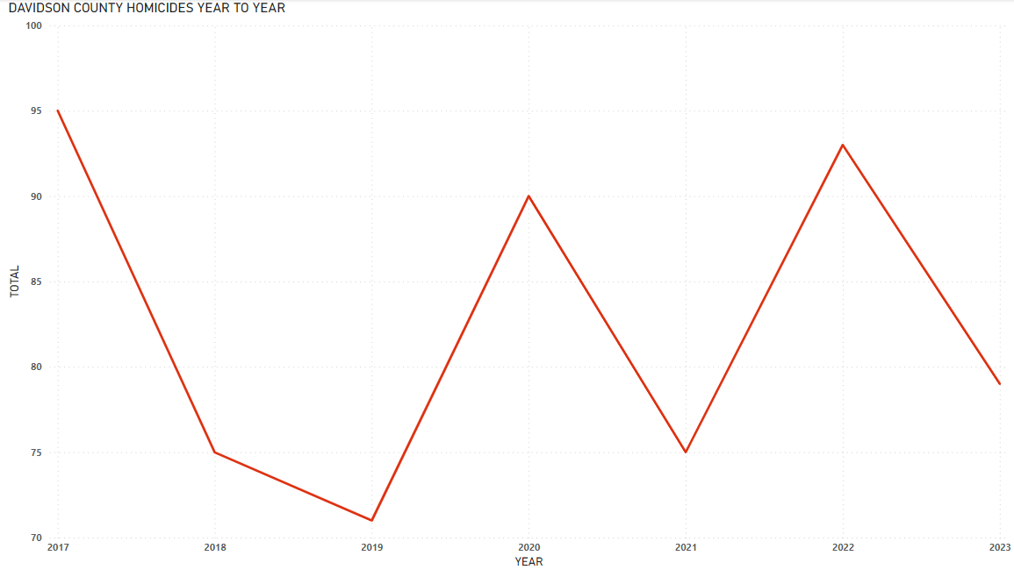

Slide 7
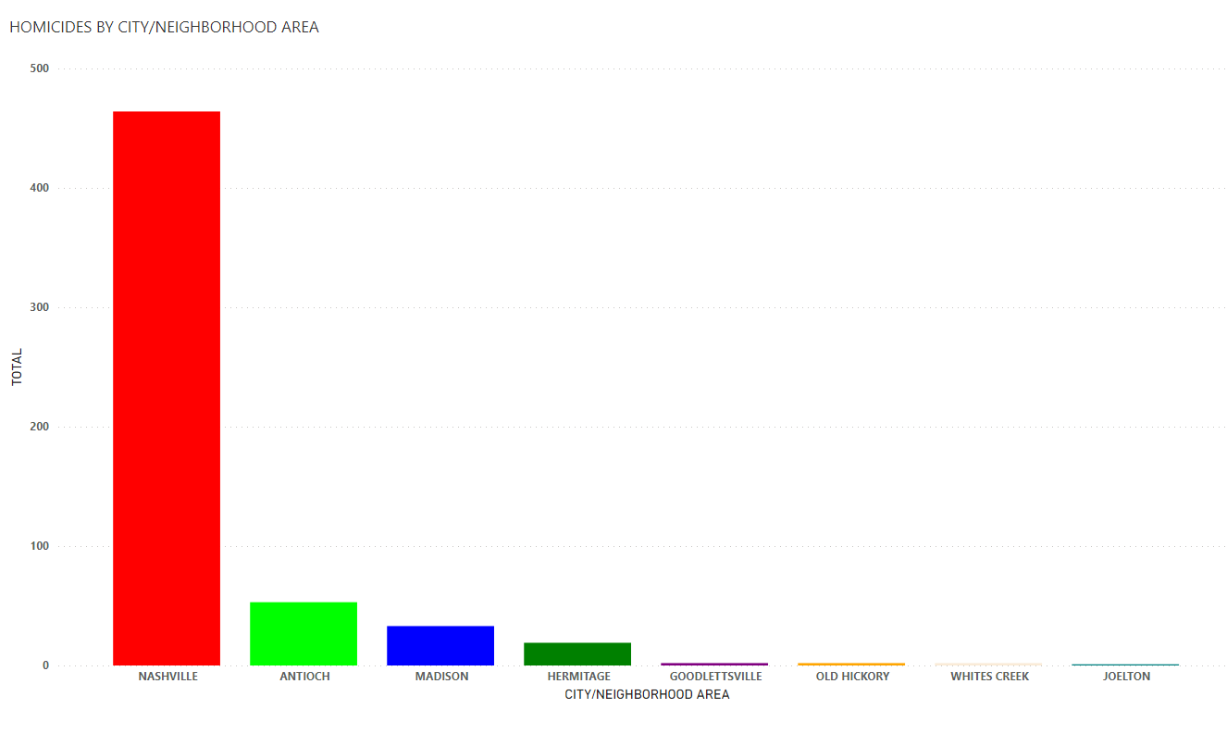

Slide 8
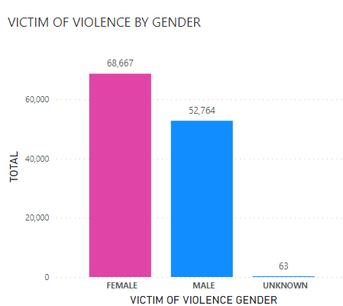
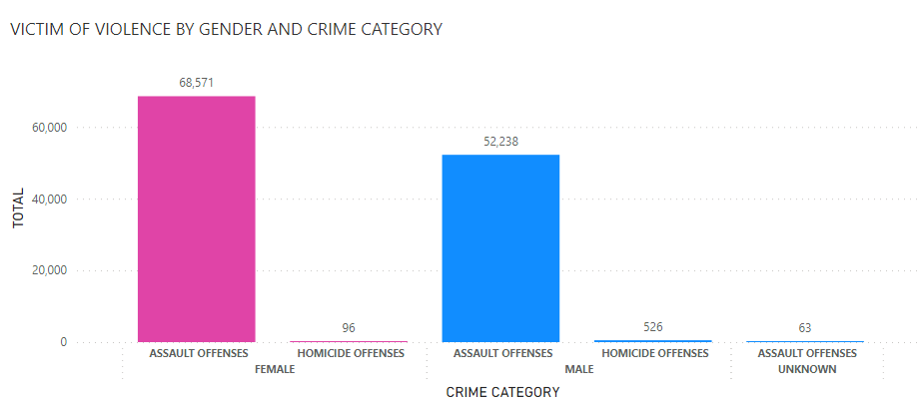
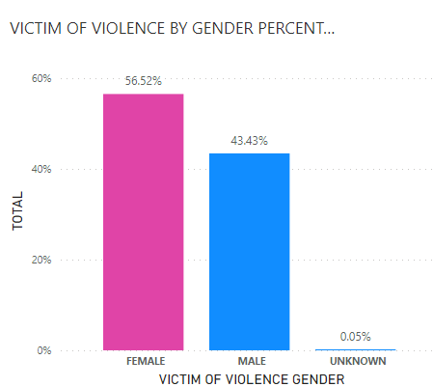
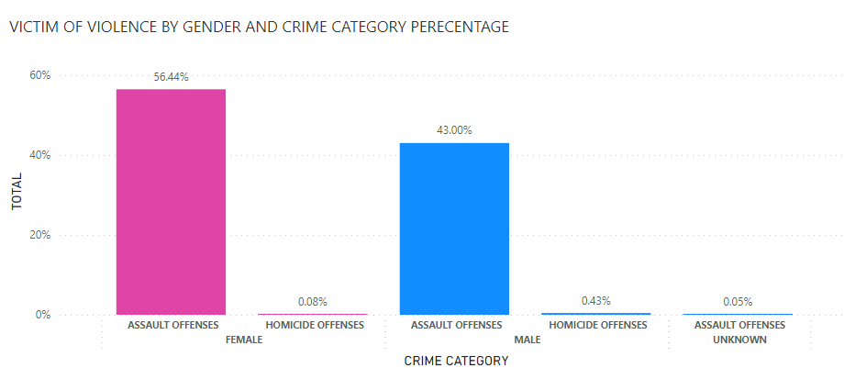
DEMOGRAPHICS: GENDER VIOLENT CRIMES

Slide 9
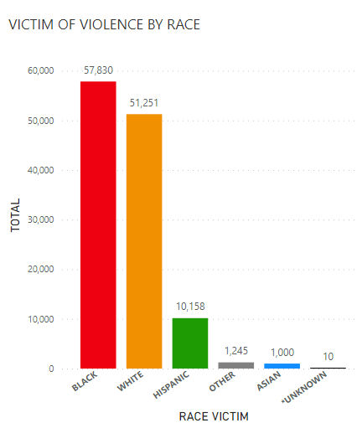
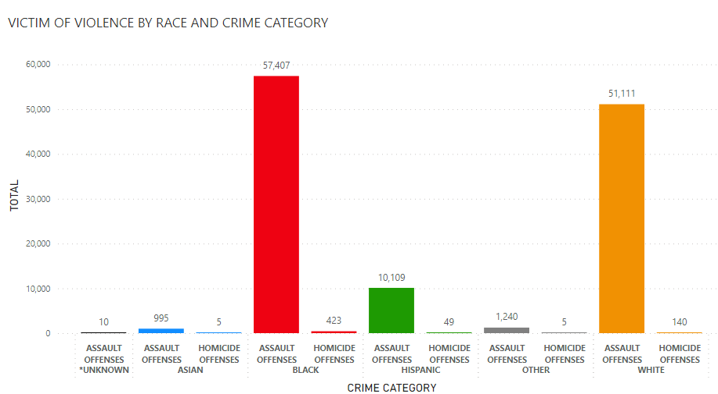
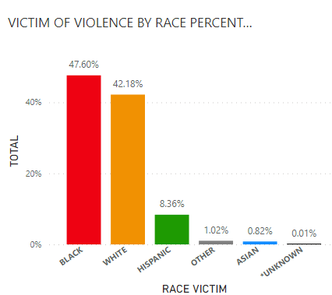
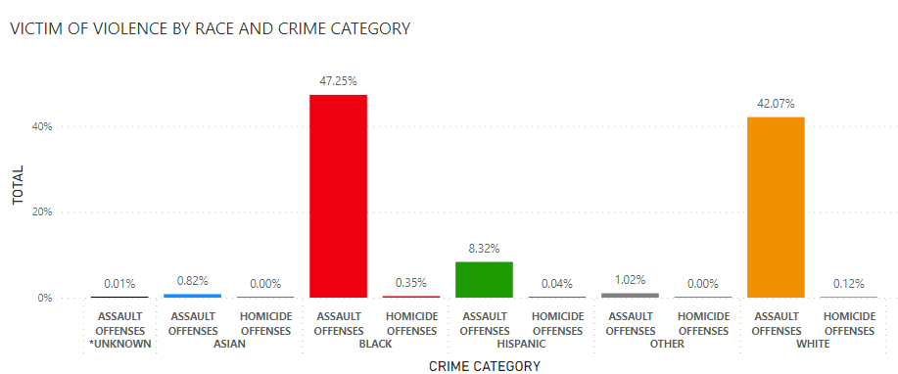
DEMOGRAPHICS: RACE VIOLENT CRIMES

Slide 10
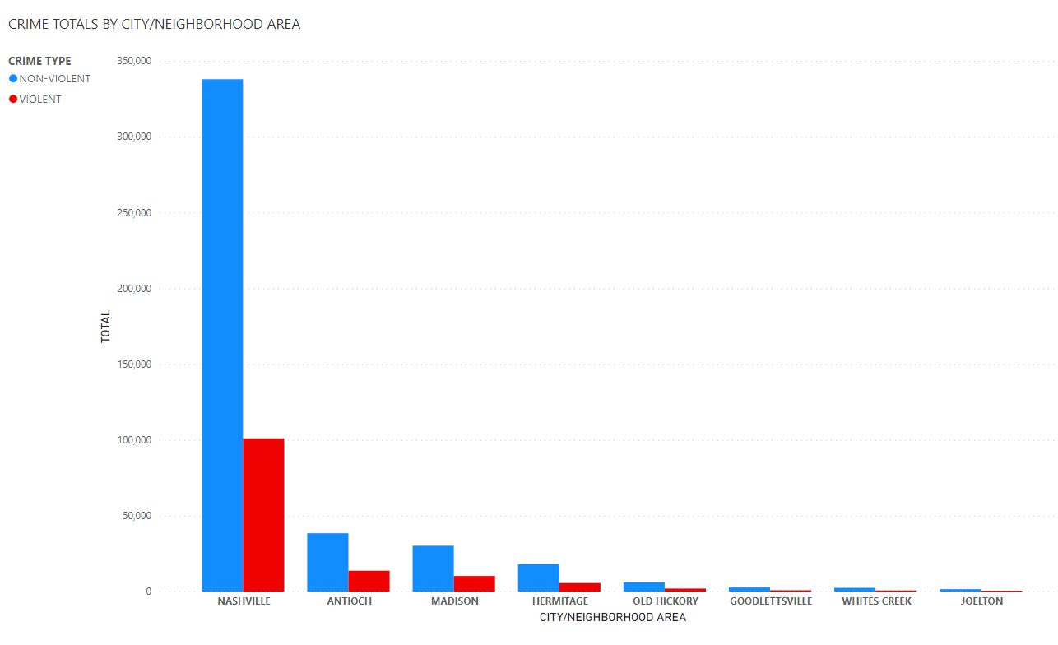
GOODLETTSVILE
JOELTON
OLD HICKORY
WHITES CREEK
*LOWEST REPORTED POLICE INCIDENTS

Slide 11
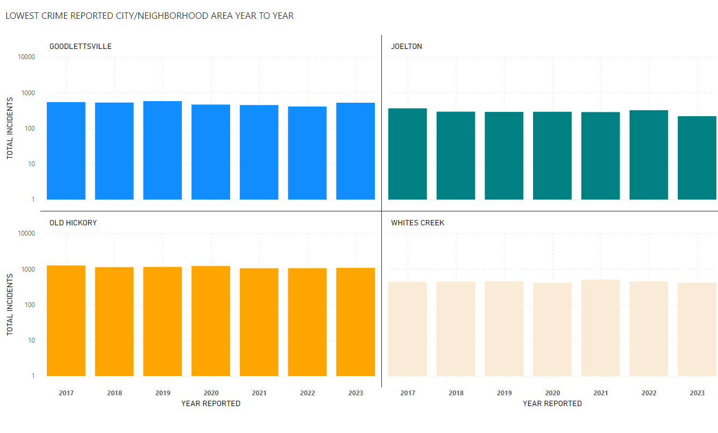

Slide 12
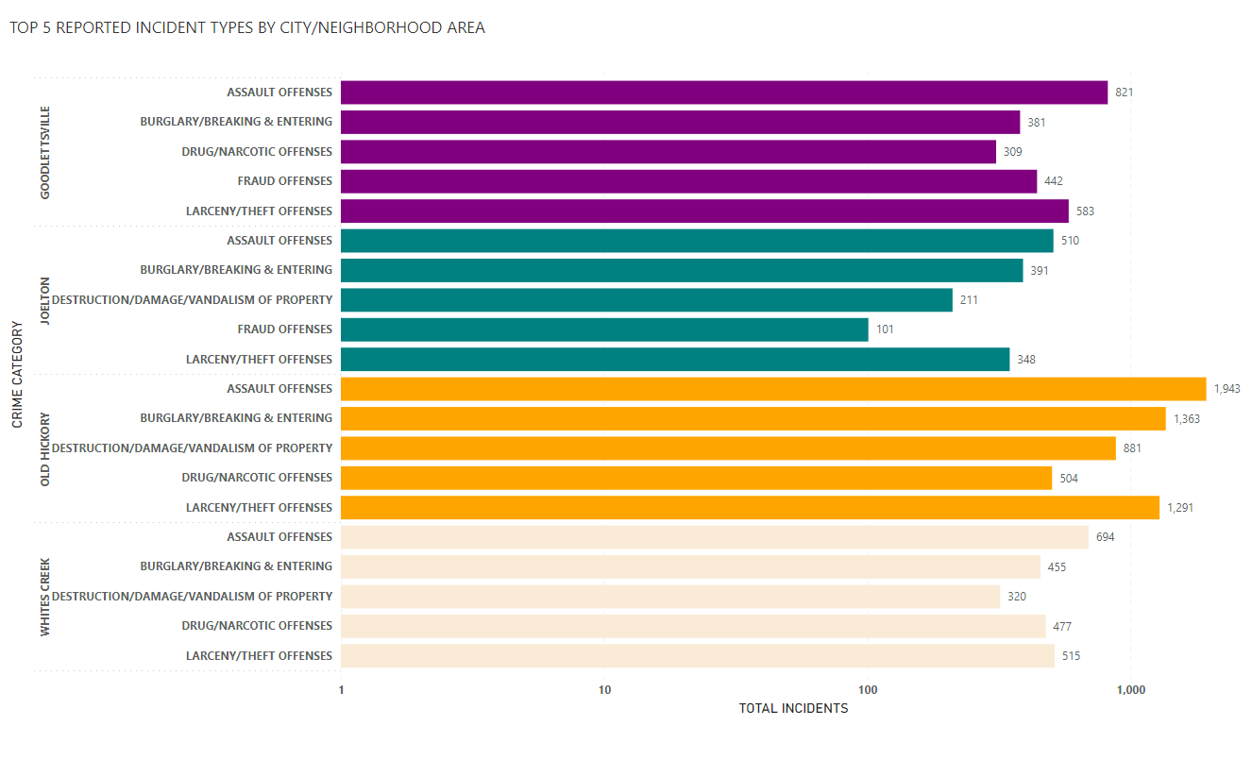

Slide 13
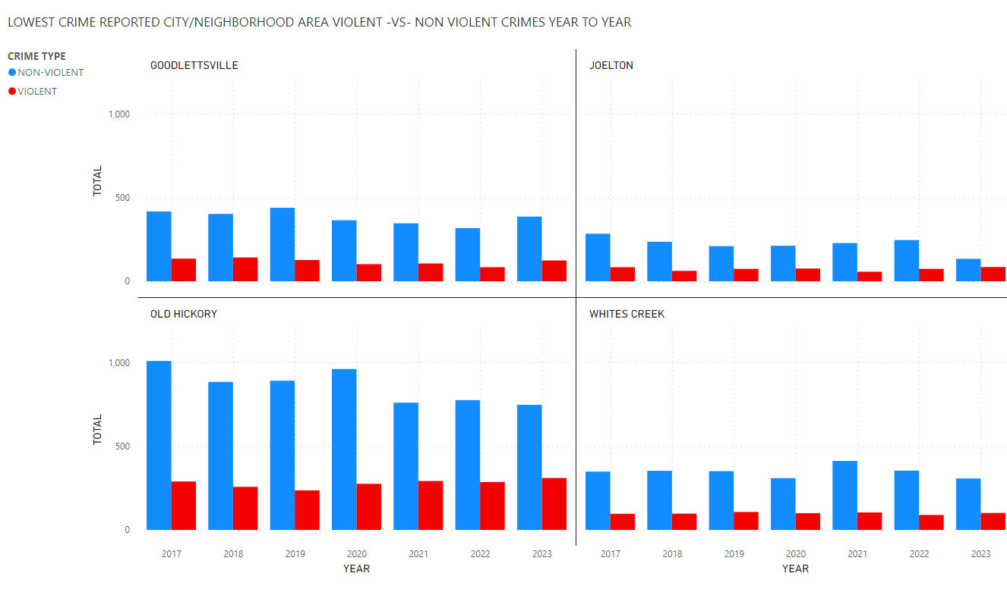

Slide 14
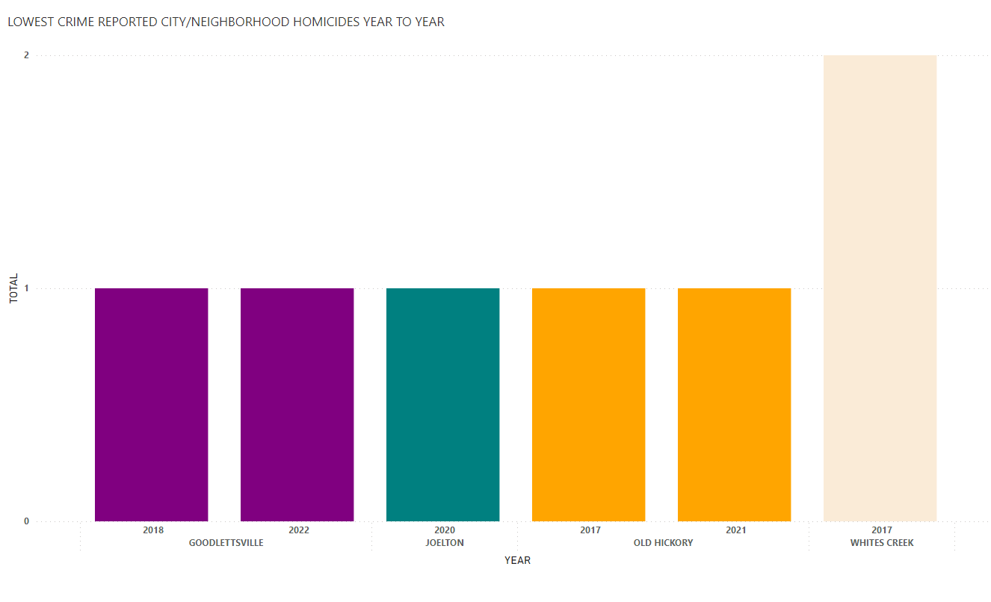

Slide 15
CONLUSION/SUMMARY:
POPULATION AND CRIME
AS POPULATION INCREASES AND DECREASES THE CRIME RATE DOES SO ACCORDINGLY. POPULATION IMPACTS CRIME.
2019 HAD THE GREATEST DECREASE IN CRIME COMPARED TO THE PREVIOUS YEARS IN DAVIDSON COUNTY .
2021 TO 2023 HAD THE GREATEST SPIKE IN CRIME ON A YEAR TO YEAR BASIS WITH THE GROWTH OF THE POPULATION.
THE PER CAPITA ON A YEAR-TO-YEAR BASIS FOR CRIMES DOES NOT HAVE A SIGNIFICANT CHANGE IN VIOLENT CRIMES VERSUS NON - VIOLENT CRIMES. THE EXCEPTION YEAR IS 2021. THE NON-VIOLENT CRIMES DECREASED TO 5% COMPARED TO OTHER YEARS WHERE THE AVERAGE WAS BETWEEN 6% AND 7%.
VIOLENT CRIME AND DEMOGRAPHICS
FEMALES ARE VICTIMS OF VIOLENT CRIMES MORE OFTEN THAN MALES.
MALES ARE MORE OFTEN VICTIM OF HOMICIDE OFFENSES COMPARED TO FEMALES.
THE BLACK AND WHITE RACES ARE IMPACTED MOST OFTEN BY VIOLENT CRIME.
THE BLACK RACE ARE VICTIMS OF ASSAULTS AND HOMICIDES MORE OFTEN COMPARED TO OTHER RACES. THE WHITE RACE IS THE SECOND MOST IMPACTED.
LOWEST POLICE INCIDENTS (CRIME) CITY/NEIGHBORHOOD AREA
GOODLESTVILLE, JOELTON , OLD HICKORY AND WHITES CREEK ARE THE BEST CITY/NEIGHBORHOOD AREA TO LIVE IN THOUGHOUT DAVIDSON COUNTY WITH THE LOWEST CRIME ON A YEAR-TO-YEAR BASIS. OLD HICKORY HAS THE HIGHEST VIOLENT CRIME RATE OF THE FOUR CITY/NEIGHBORHOOD AREAS.

